Slide 1

Solar Power
Prediction
Using Regression

Slide 2
Project Developed By
Priyanka Omprakash Yadav
Ruthvik Chowdary Sukhavasi

Slide 3
Contents
Introduction & Problem Statement
Data Overview
EDA Insights
Model Building
Model Evaluation
Deployment
Conclusion

Slide 4
Introduction & Problem Statement
Introduction
Solar power output depends on weather conditions.
Accurate prediction helps in grid management and planning.
Problem Statement
Build an ML model to predict solar power generation under any weather.
Use environmental factors like temperature, humidity, wind, and sky cover.
Aim: achieve high accuracy across all conditions.

Slide 5
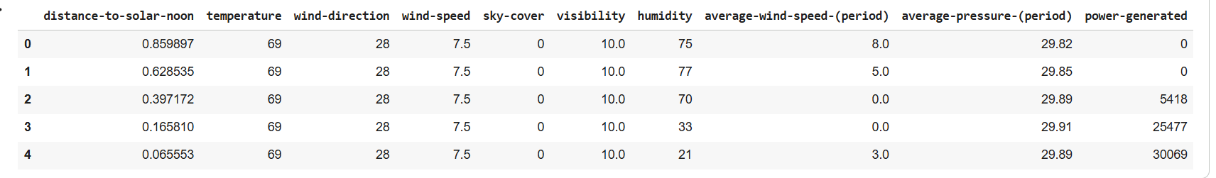
Data Overview
  This project focuses on predicting solar energy production using environmental factors such as temperature, wind speed, humidity, and sky cover.
  The dataset solarpowergeneration.csv contains 2,920 records and 10 variables, including:

Slide 6
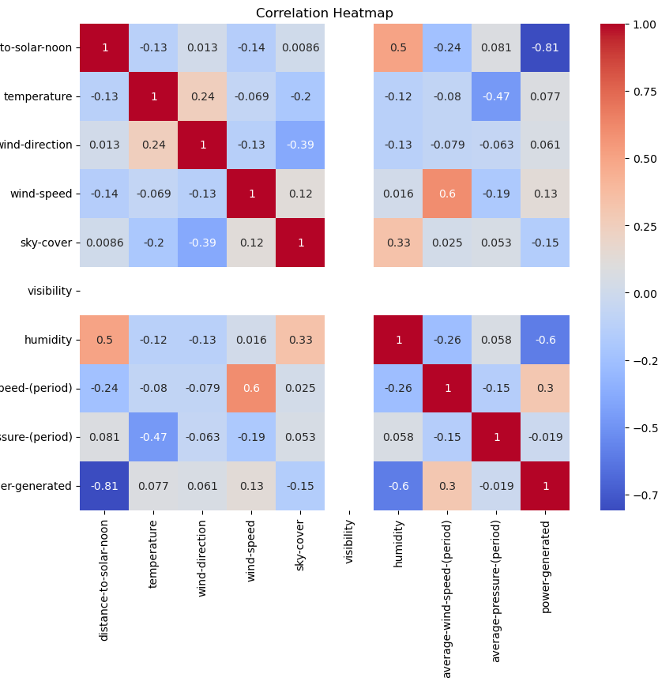
EDA Insights
Data cleaning
Correlation Insights
Visualization Findings

Slide 7
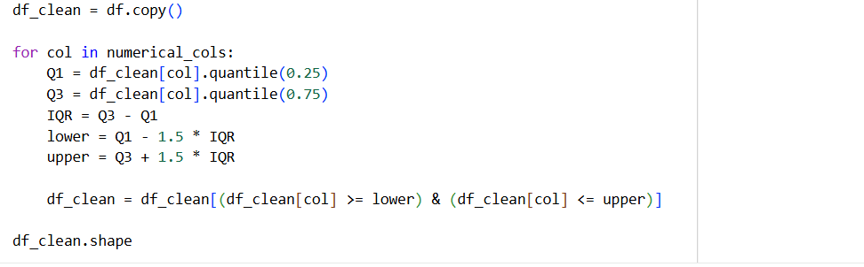
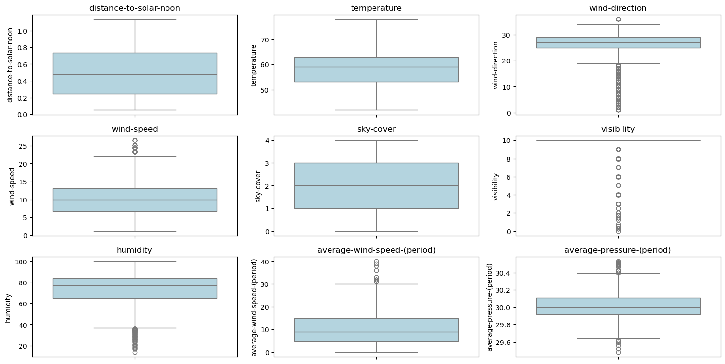
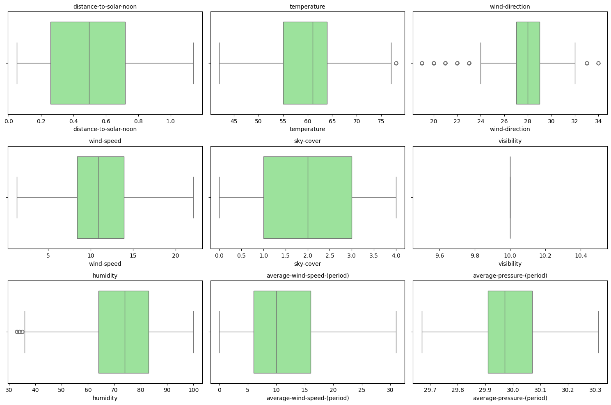
Box Plot Insight:

Slide 8
Model Building
Input (X) Variables: distance_to_solar_noon, temperature, wind_direction, wind_speed, sky_cover, visibility, humidity, average_wind_speed, average_pressure.
Target (Y) Variable: power_generated
Models Used
Linear Regression, Ridge Regression, Lasso Regression, Random Forest Regressor, XGBoost Regressor.

Slide 9
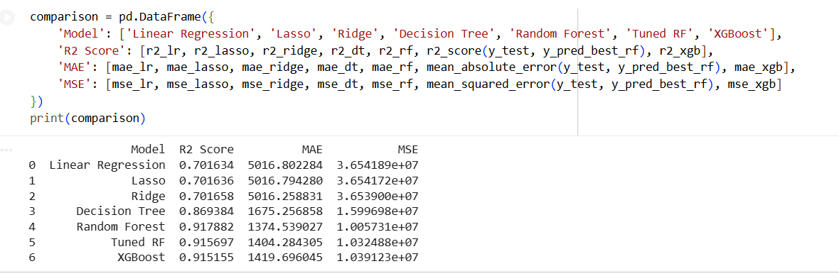
Model Evaluation
We tried different models — Linear, Lasso, Ridge, Decision Tree, Random Forest, and XGBoost. Tuned Random Forest achieved the best performance (R² = 0.917) and was selected as the final model.

Slide 10
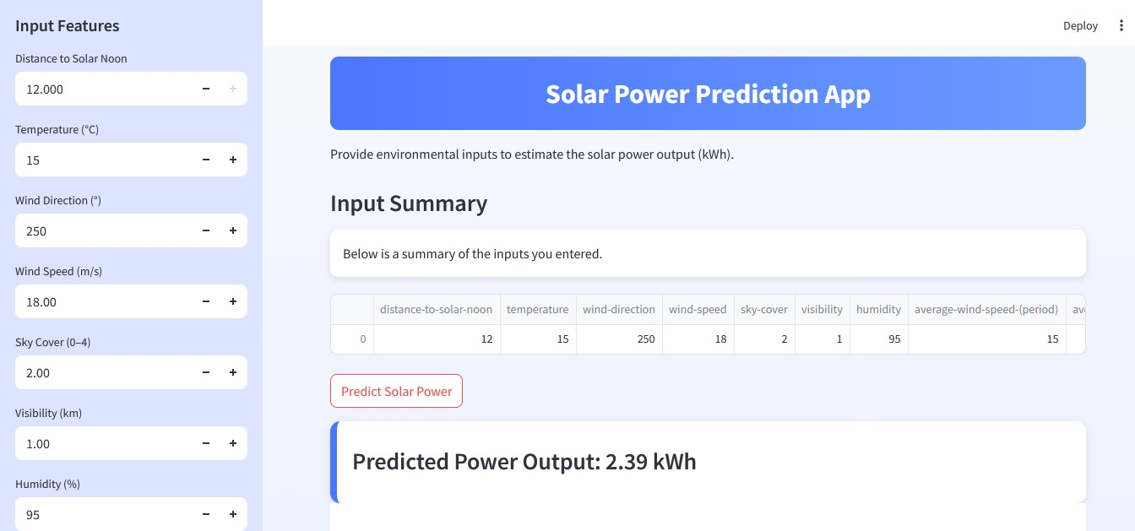
Deployment

Slide 11
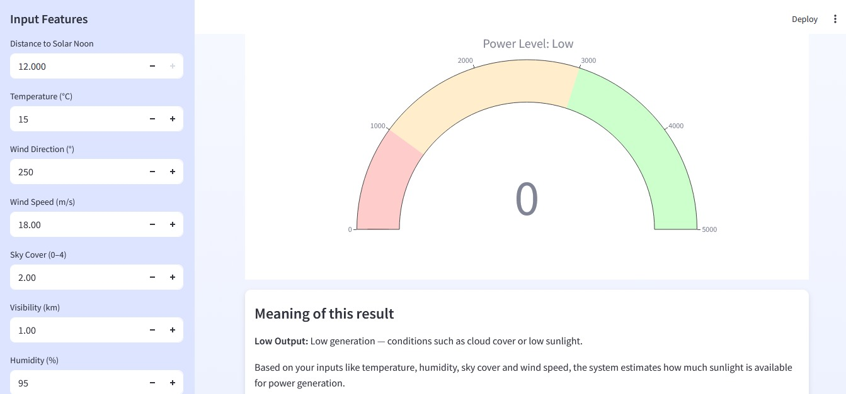

Slide 12

Conclusion
The Random Forest model achieved an R² score of 0.917, accurately predicting solar power generation under all weather conditions. This supports efficient energy planning and grid management.

Slide 13

Thank you

